Slide 1
QA evaluation form

Slide 2
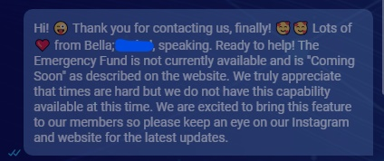
1. Begin properly
You start a warmhearted and sparkle interaction in an effortless attitude while greeting the member by their name, you demonstrate understanding on their primary request and willingness to help and solve it.

Slide 3
2. Active listenning
You are lovably committed and warmly attentive by asking probing and clarifying questions, while displaying empathy all the time and showing the member you are interested in going deeper down to solve everything properly.
Member: I’ve been trying to change my phone number and cannot find the way to do it, I feel so frustrated because I also lost my job yesterday, please help!
Agent: To change your phone number, go to the ME section on the app and change it.

Slide 4
3. Product & System Knowledge
You utilize available tools to determine what is necessary to know about a member along with their inquiry. You know what can and cannot be done in our systems and are up-to-date on products.
Agent widget (AW)
Handbook
Application
App screenshots steps
App manual steps document
Website

Slide 5
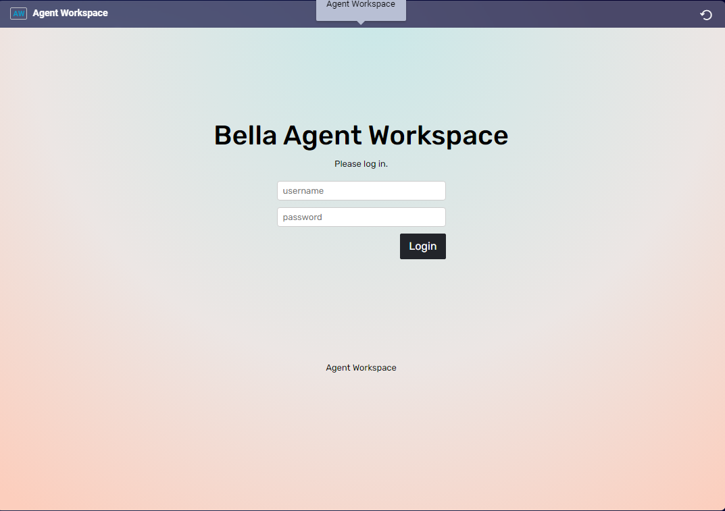
Widget

Slide 6
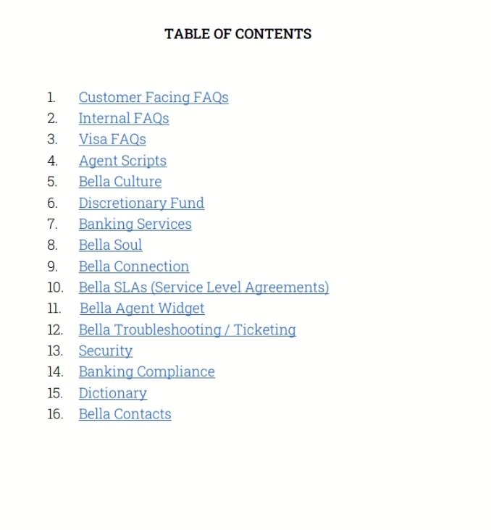
Handbook

Slide 7
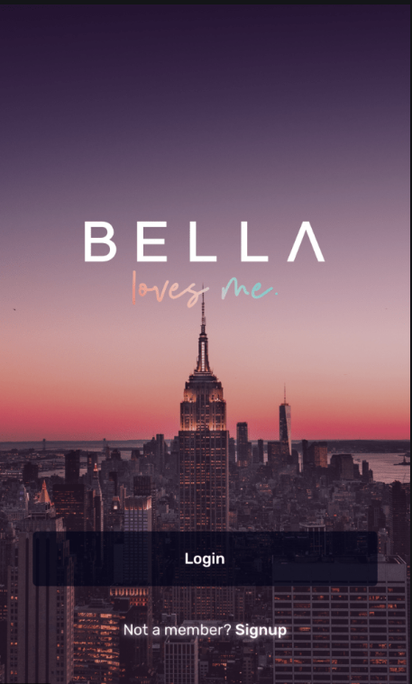
Application

Slide 8
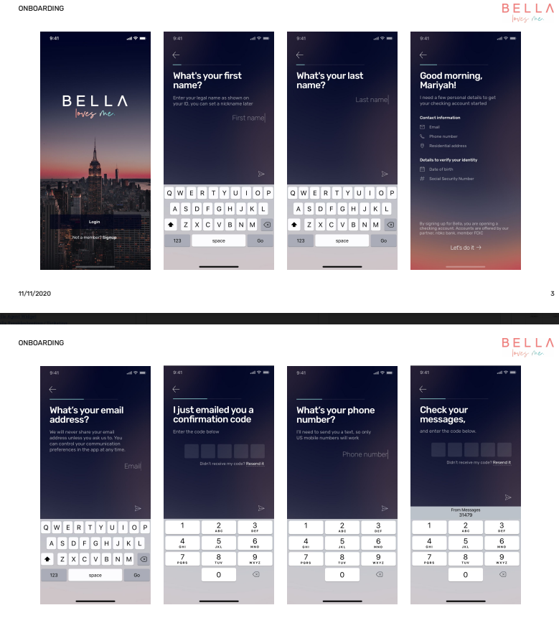
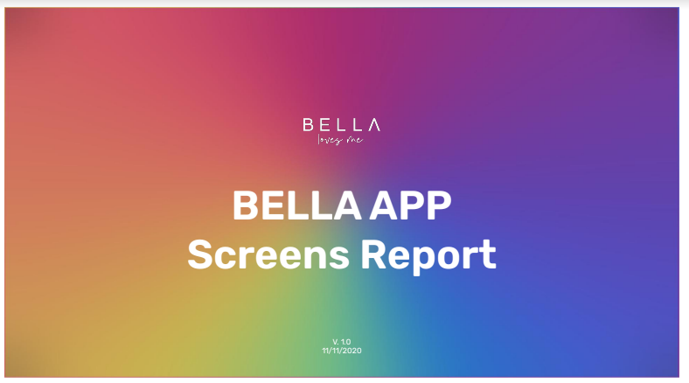
App screenshots steps

Slide 9
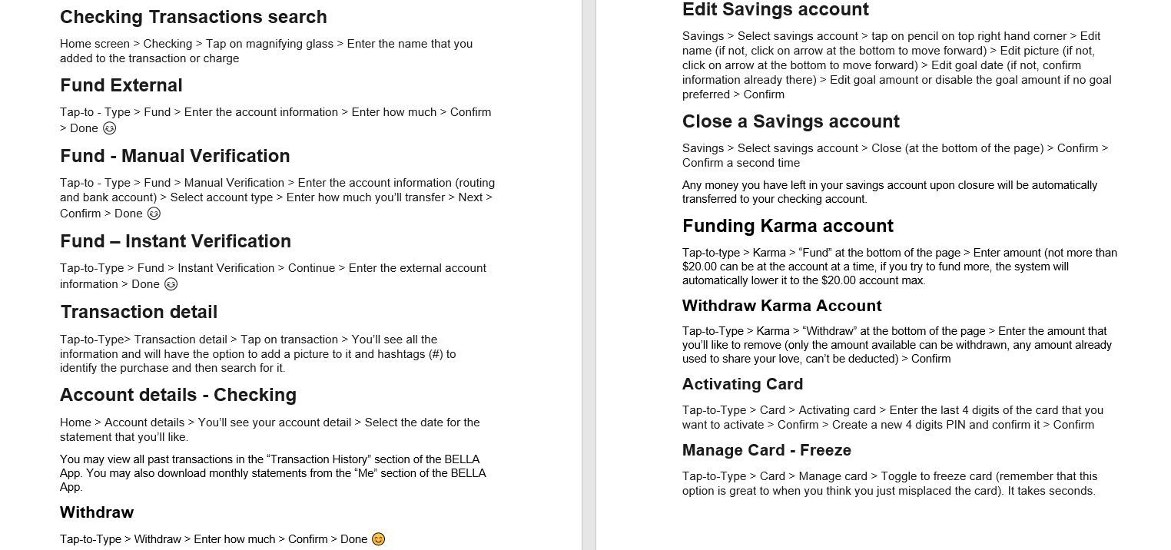
App manual steps document

Slide 10
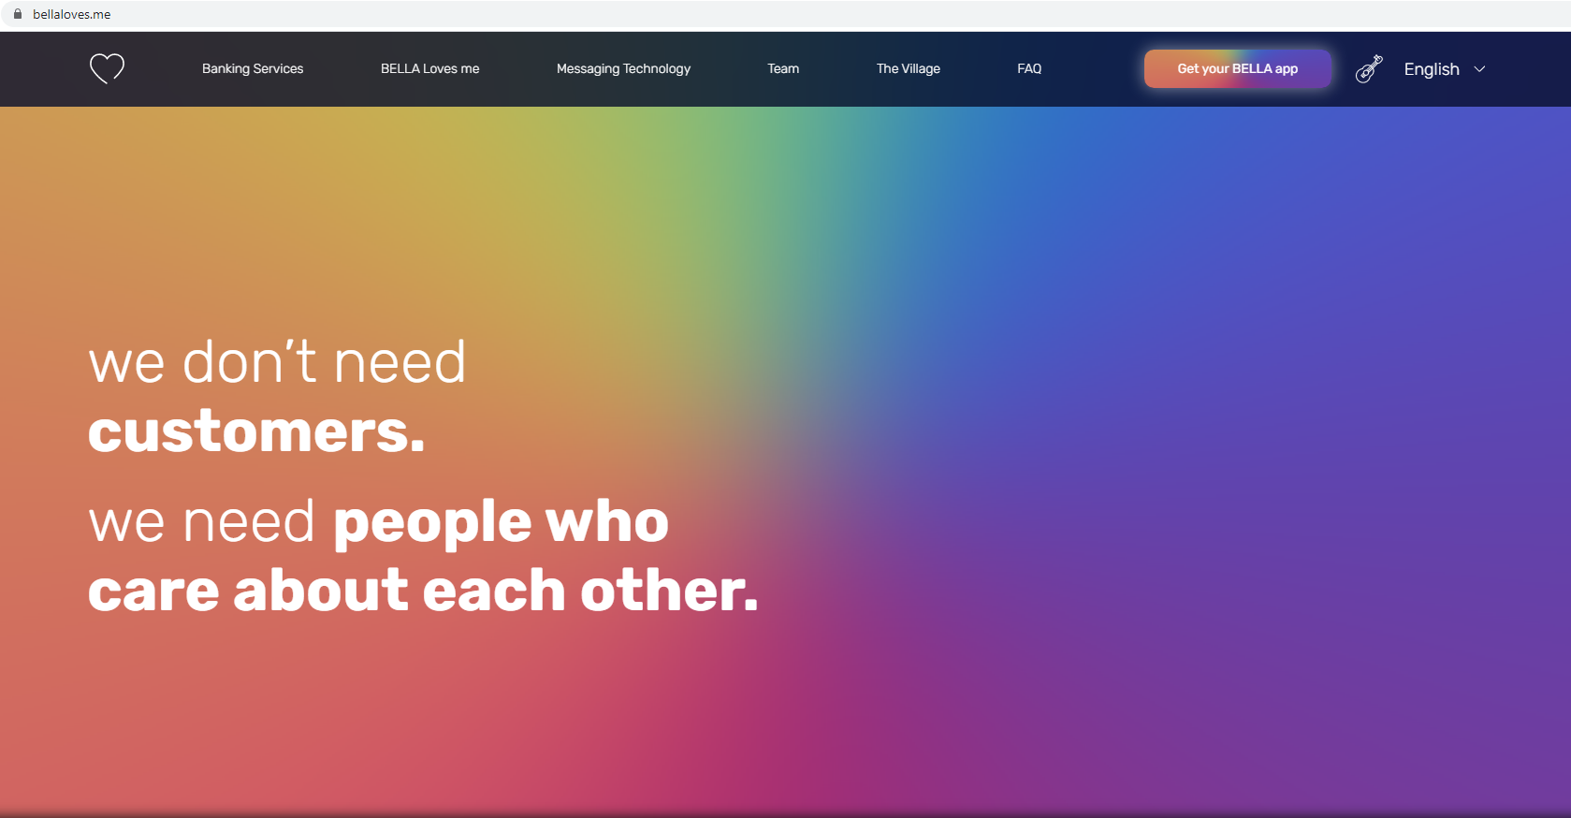
Website

Slide 11
4. Resolution path
You use what you know and what you learn during an interaction to identify the member's concern and decide on a path forward, you follow up the correct course of action respecting app's troubleshooting.
Member: I am unable to activate the Bella card even though I followed all the correct steps to do it, I already force closed the app, I have the latest software version of IOS and also have the last version of the app, what else should I do?
Agent: Did you try uninstalling the app and reinstall it back again?

Slide 12
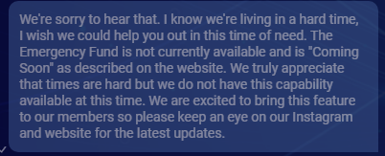
5. Ownership
You demonstrate kindness and understanding while taking responsibility for the resolution, also speak or write in a lovely, friendly and empathic manner.
Member: I’m broke and need to pay rent.
Agent: Well, right now the emergency fund is not available until further notice, do you need something else?

Slide 13
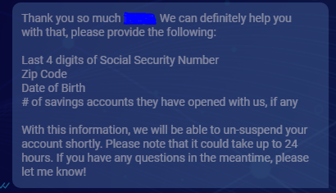
6. Procedural Compliance
You complete all necessary documentation on the account and follow prescribed procedures, while being one step ahead of getting done and solving all as stated.
Member: My account is suspended because I tried too much time with the incorrect password, unsuspend it please. Do you need anything from me?
Agent: Sure I can do that for you, I actually don’t need any information from you to go forward, please allow me a moment while I unsuspended it.

Slide 14
7.0 Attentive and focused
Acknowledge the member's primary inquiry along with the solution provided by another agent on a previous interaction, to display interest and attentiveness all the time.
Example of a conversation after it was transferred:
Agent: Hello Patrick! 😊 Thank you very much for contacting Bella, it's definitely a pleasure for us to have you here as part of our family. ❤️
I can see you were transferred from a previous interaction trying to activate your card, please follow the next steps and let me know if it works successfully at the end. Tap-to-Type > Card > Activating card > Enter the last 4 digits of the card that you want to activate > Confirm > Create a new 4 digits PIN and confirm it > Confirm
I’ll be here for you to confirm with us, but you can take your time.
Agent: Hello there! I see you have been transferred, how may I help you again?

Slide 15
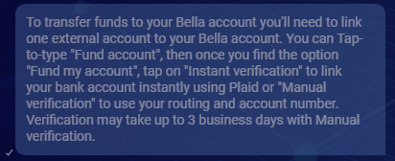
8. Adequate use of spelling
Appropriate use of grammar, punctuation and capitalization rules throughout the conversation. (Correct use of emojis)

Slide 16
9. Security and control
Secure and protect the member's privacy and personal information. Must not supply exclusive details without accurately knowing the member's account.
Member: I haven’t received my card yet, I want to check if my residence address entered on my Bella account is the correct one?
Agent: Yes I’ll be more than glad to verify this information for you, would you please provide me the same residence address you entered during the sign up process to see if it matches with the one we have on our system? Thank you in advance!
Agent: Is this the correct residence address? 0116 3th Ave NW. Detroit DT 55788

Slide 17
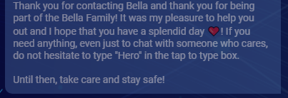
10.0 Willingness and gratitude
Set the expectations with the member throughout the interaction and thank them for choosing us at the end of the conversation.

Slide 18
Business critical
1. Used rude tone/ profanity / abusive language / continual interruption of the member.
2. Disconnected message thread without responding at any point.
-Don’t close the interaction before providing a complete solution to the member, before setting all the expectations with them or by interrupting the member after a questions was asked on their side.
3. Negatively presented company / product / affiliates.
-Don’t speak on an inappropriate manner of the company’s name or its products.
4. Disregarded data protection.
-Must secure all the personal information of the member without providing it.
5. Provided incomplete and or inaccurate information during the interaction (Misleading / misrepresentation / avoid answering the member's questions).
-If you withdraw funds from an ATM you’ll also have to cover the fees.
-Bella doesn’t have insurance.
-You can use the Bella app on different devices at the same time. (Phone, iPad, computer …)

Slide 19
6. Unable to determine any error / strange behavior / fraud / or any curious - unusual manner from the member. Did not send the ''Fraud / Locked Accounts'' template of the predefined content when it's needed.
(Fraud / Locked accounts template)
Thank you for reaching out. I sincerely apologize for the inconvenience this has caused.
We are investigating some recent activity on your account. During this time, your account has been restricted to protect your funds while we complete our investigation. We take security very seriously and truly appreciate your patience while we look into this! And remember, BELLA is designed to ensure that your money is always safe.
To begin our investigation, please send the following information via this chat:
- Full Name
- DOB
- Last four of SSN
- Email address
- How many savings accounts, if any, you have open
Additionally, please use the registered email address on your BELLA account to send the following documents (pdf or jpg) to Compliance@bellaloves.me. Please do not send these over this chat.
- Pictures of the front and back of your drivers' license, passport, or government ID
- The most recent statement of your linked bank account
- A screenshot or PDF of the bank account from which you pulled recent funds, verifying that you had sufficient funds to make that transaction.
Thank you for your understanding in this matter and for assisting us in this investigation.

